Slide 1

Hotel Reservation analysis with SQL
Presented by
SARAVANAN VEERAKUMAR
Data Analyst Intern
Mentorness, Batch: MIP-DA-10

Slide 2

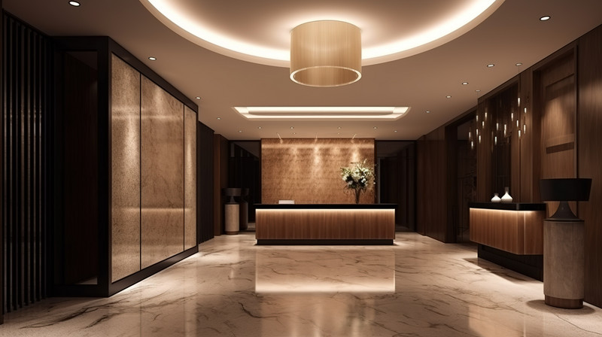


Business Problem:
Hotel industry is volatile in nature and requires regular streamlining of operations to provide a superior guest experience. With this business objective in mind, we are analyzing the hotel reservation dataset to gain valuable insights into guest preferences, booking trends, and other critical factors. By examining the dataset's features, we aim to derive actionable insights and make data-driven decisions that enhance business growth. This approach helps us stay ahead of market trends and competitors, ensuring state-of-the-art guest experiences.
GOALS of our analysis using SQL:
To know the popular meal plan and room type among guests.
Role of demographic factors influencing the room reservations.
Periodical and seasonal factors affecting the room reservations.
Analysing lead times (Time between booking and arrival)
Evaluating market segments and their revenue contribution.

Slide 3

Diving into dataset features:
The dataset includes the following columns:
Booking_ID: A unique identifier for each hotel reservation.
no_of_adults: The number of adults in the reservation.
no_of_children: The number of children in the reservation.
no_of_weekend_nights: The number of nights in the reservation that fall on weekends.
no_of_week_nights: The number of nights in the reservation that fall on weekdays.
type_of_meal_plan: The meal plan chosen by the guests.
room_type_reserved: The type of room reserved by the guests.
lead_time: The number of days between booking and arrival.
arrival_date: The date of arrival.
market_segment_type: The market segment to which the reservation belongs.
avg_price_per_room: The average price per room in the reservation.
booking_status: The status of the booking.

Slide 4

Analysis Objectives
Key Questions Addressed:
1. What is the total number of reservations in the dataset?
2. Which meal plan is the most popular among guests?
3. What is the average price per room for reservations involving children?
4. How many reservations were made for the year 20XX (replace XX with the desired year)?
5. What is the most commonly booked room type?
6. How many reservations fall on a weekend (no_of_weekend_nights > 0)?
7. What is the highest and lowest lead time for reservations?
8. What is the most common market segment type for reservations?
9. How many reservations have a booking status of "Confirmed"?
10. What is the total number of adults and children across all reservations?
11. What is the average number of weekend nights for reservations involving children?
12. How many reservations were made in each month of the year?
13. What is the average number of nights (both weekend and weekday) spent by guests for each room type?
14. For reservations involving children, what is the most common room type, and what is the average price for that room type?
15. Find the market segment type that generates the highest average price per room.

Slide 5


Total Number of Reservations
SELECT COUNT(Booking_ID) FROM hotel_reservation
Result: 700

Slide 6
Most popular Meal plan
SELECT DISTINCT type_of_meal_plan FROM hotel_reservation;
SELECT COUNT(type_of_meal_plan) FROM hotel_reservation WHERE type_of_meal_plan='Meal Plan 1’
SELECT COUNT(type_of_meal_plan) FROM hotel_reservation WHERE type_of_meal_plan='Meal Plan 2’
SELECT COUNT(type_of_meal_plan) FROM hotel_reservation WHERE type_of_meal_plan='Not Selected'
Result: Meal Plan 1

Slide 7
Average Price per Room for Reservations Involving Children
SELECT AVG(avg_price_per_room) AS Average_price_per_room_for_reservations_involving_children FROM hotel_reservation WHERE no_of_children>=1;
Result: 144.57

Slide 8
Reservations by Year
SELECT YEAR(arrival_date) AS YEAR, COUNT(Booking_ID) AS Total_Bookings from hotel_reservation GROUP BY YEAR ORDER BY YEAR;
Result:
123 for Year 2017
577 for Year 2018

Slide 9
Most Commonly Booked Room Type
SELECT room_type_reserved, COUNT(room_type_reserved) AS Total_Bookings FROM hotel_reservation GROUP BY room_type_reserved ORDER BY room_type_reserved;
Result:
Room_Type 1

Slide 10
Reservations on Weekends
SELECT COUNT(Booking_ID) AS Reservations_fall_on_Weekend FROM hotel_reservation
WHERE no_of_weekend_nights>0;
Result: 383

Slide 11
Lead Time Analysis
SELECT MAX(lead_time) AS Highest_lead_time FROM hotel_reservation;
SELECT MIN(lead_time) AS Lowest_lead_time FROM hotel_reservation WHERE lead_time>0;
Result:
Highest- 443
Lowest- 01

Slide 12
Common Market Segment Type
SELECT market_segment_type, COUNT(market_segment_type) AS Total_Bookings FROM hotel_reservation
GROUP BY market_segment_type ORDER BY market_segment_type;
Result: Online (518)

Slide 13
Booking Status Analysis
SELECT DISTINCT booking_status FROM hotel_reservation;
SELECT COUNT(Booking_ID) AS Booking_Status_Confirmed FROM hotel_reservation WHERE booking_status='Not_Canceled’;
SELECT COUNT(Booking_ID) AS Booking_Status_Confirmed FROM hotel_reservation WHERE booking_status='Canceled';
Result: Null

Slide 14
Total Number of Adults and Children
SELECT SUM(no_of_adults) AS Total_no_of_adults, SUM(no_of_children) AS Total_no_of_children
FROM hotel_reservation;
Result:
Adults- 1316
Children- 69

Slide 15
Average Weekend Nights for Reservations Involving Children
SELECT AVG(no_of_weekend_nights) AS Avg_no_of_weekend_nights_for_reservations_involving_children FROM hotel_reservation WHERE no_of_children>0;
Result: 01

Slide 16
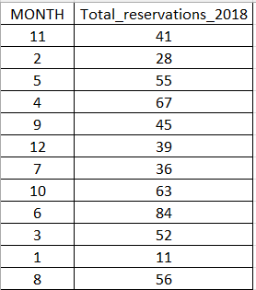
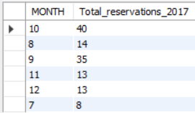
Monthly Reservations
SELECT DISTINCT MONTH(arrival_date) AS MONTH, COUNT(Booking_ID) AS Total_reservations_2017 FROM hotel_reservation WHERE YEAR(arrival_date)=2017 GROUP BY MONTH(arrival_date);
SELECT DISTINCT MONTH(arrival_date) AS MONTH, COUNT(Booking_ID) AS Total_reservations_2018 FROM hotel_reservation WHERE YEAR(arrival_date)=2018 GROUP BY MONTH(arrival_date);

Slide 17
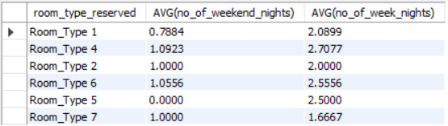
Average Nights Spent by Room Type
SELECT room_type_reserved, AVG(no_of_weekend_nights), AVG(no_of_week_nights) FROM hotel_reservation GROUP BY room_type_reserved;

Slide 18
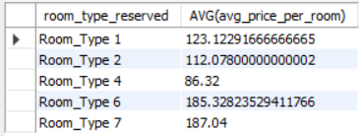
Common Room Type and Average Price for Reservations Involving Children
SELECT room_type_reserved, AVG(avg_price_per_room) FROM hotel_reservation WHERE no_of_children>0 GROUP BY room_type_reserved ORDER BY room_type_reserved;

Slide 19
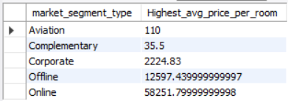
Market Segment with Highest Average Price per Room
SELECT market_segment_type, SUM(avg_price_per_room) AS Highest_avg_price_per_room FROM hotel_reservation GROUP BY market_segment_type ORDER BY market_segment_type;

Slide 20
Conclusion
Finally, We uncovered various actionable insights through this analysis using SQL from knowing the
Most popular meal plan of guests,
Influence of children and other demographic factors,
Most commonly booked room type,
Seasonal and Periodic reservation,
Lead time analysis to Market segment type that accounts for most revenue.
Analyzing such factors is paramount for any hotel business to keep pace with current trends and attract potential guests. By leveraging these insights, we are not only keeping our decisions on the right path, but also we can compete better with our fellow competitors in the industry with data-driven decisions.

Slide 21
Recommendations based on Analysis
Based on the actionable insights uncovered through this SQL analysis, we propose the following recommendations:
Enhance Meal Plan 1: Since 'Meal Plan 1' is the most popular among guests, focus on improving and promoting this meal plan to enhance guest satisfaction and attract more bookings.
Streamline Pricing for Rooms Involving Children: Offer tailored family room packages with competitive pricing to attract families with children.
Enhance Family-Friendly Amenities: Equip rooms involving children with amenities such as baby food, cribs, cots, playpens, bibs, changing stations, extra toiletries, white noise machines, toys, board games, coloring books, kid-friendly TV channels, snacks, and a kids’ menu at the hotel restaurant.
Gather Feedback Data: Implement interactive features like surveys and chatbots to regularly collect feedback from guests. Ensure future data collection includes more features for deeper insights.

Slide 22
Recommendations Cont..,
Enhance Online Reservation User Experience: Since the most common market segment type is online, focus on improving the user experience for online reservations by designing a visually appealing and user-friendly UI. Offer valuable data collection surveys on the official website to gain insights into guests' experiences and streamline hotel operations.
Enhance Guest Experience in Room Type 1: Since 'Room_Type 1' is the most popular among guests, focus on improving the guest experience in this room type to maintain and increase its popularity.
Adopt Overbooking Management Techniques: To minimize cancellations, implement overbooking management techniques. Monitor occupancy rates closely, use accurate and robust forecasting models, and always have a backup plan in place to better manage inventory and reduce cancellations.

Slide 23
Recommendations Cont..,
Enhance Weekend Experience for Families: Optimize the weekend experience to be more children-friendly, as the average number of children is higher than adults during weekend reservations.
Optimize Inventory in Real Time: Actively manage room allocations, cancellations, and last-minute changes in real time to minimize the impact of overbookings. A well-coordinated system can optimize room availability, avoid overbookings, and maintain high guest satisfaction.
Accurate Forecasting: Develop a solid understanding of historical data, booking trends, and market demand to manage overbookings effectively. Utilize robust forecasting models that consider seasonal variations, events, and historical booking patterns to accurately predict occupancy rates. This will help in assessing the number of rooms available for overbooking without compromising guest satisfaction.

Slide 24



Thank you
Kindly reach out to me if you have any questions or clarifications regarding this analysis.
www.linkedin.com/in/saravanan-veerakumar190796
https://github.com/Saravanan-Veerakumar
Saravananv1925@gmail.com

